Slide 1
Arhitecturi Paralele Introducere GPU
Lect. Dr. Ing. Cristian Chilipirea – cristian.chilipirea@mta.ro

Slide 3
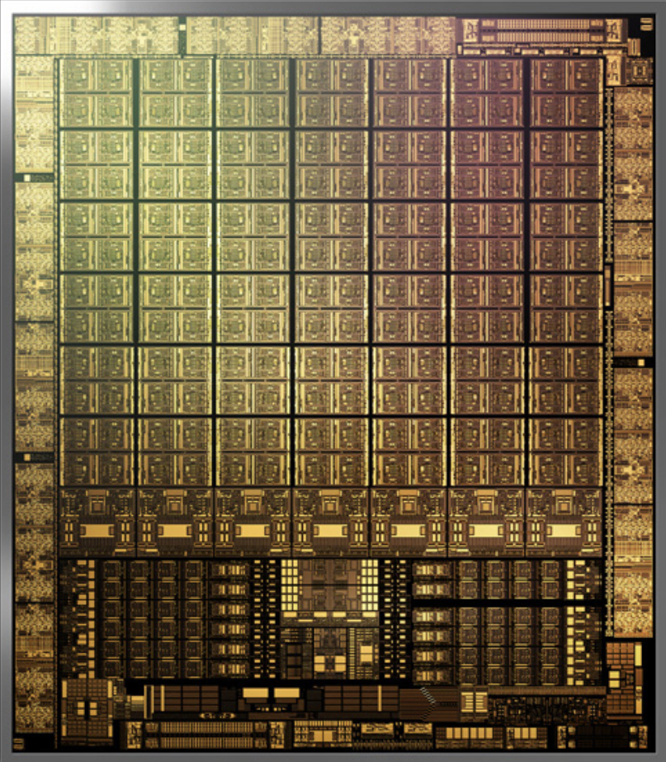
NVIDIA Ampere
Notes:
https://www.gigabyte.com/FileUpload/Global/KeyFeature/1623/innergigabyteimages/slide-img-1.jpg

Slide 4
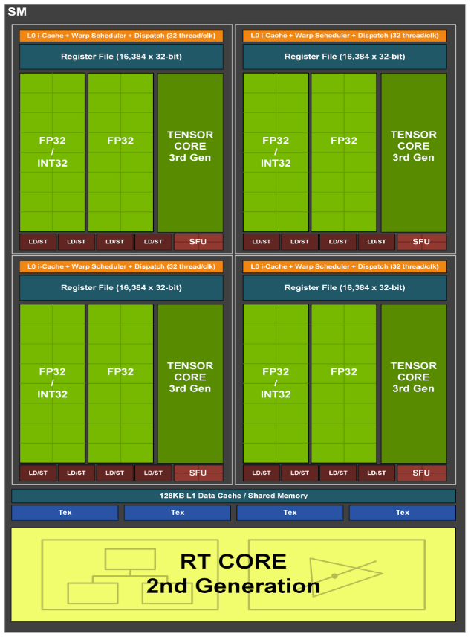
NVIDIA Ampere v2
Notes:
https://www.nvidia.com/content/PDF/nvidia-ampere-ga-102-gpu-architecture-whitepaper-v2.pdf

Slide 5
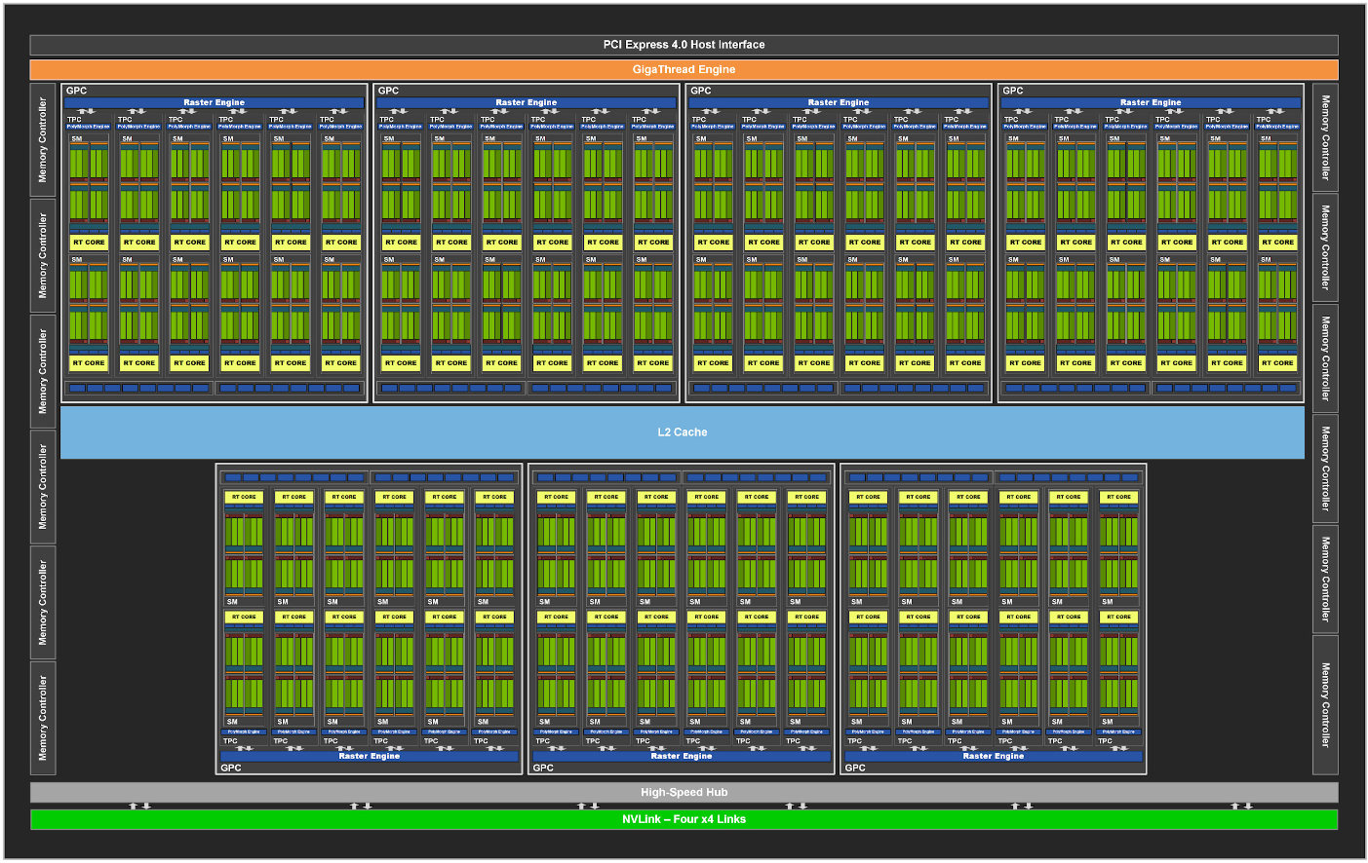

Slide 6
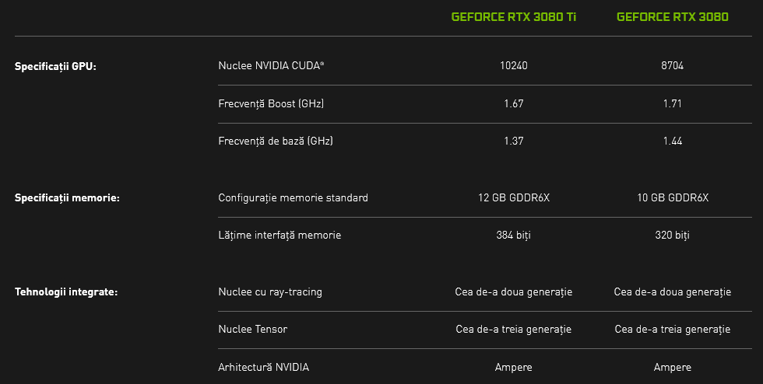
Notes:
https://www.nvidia.com/ro-ro/geforce/graphics-cards/30-series/rtx-3080-3080ti/

Slide 7
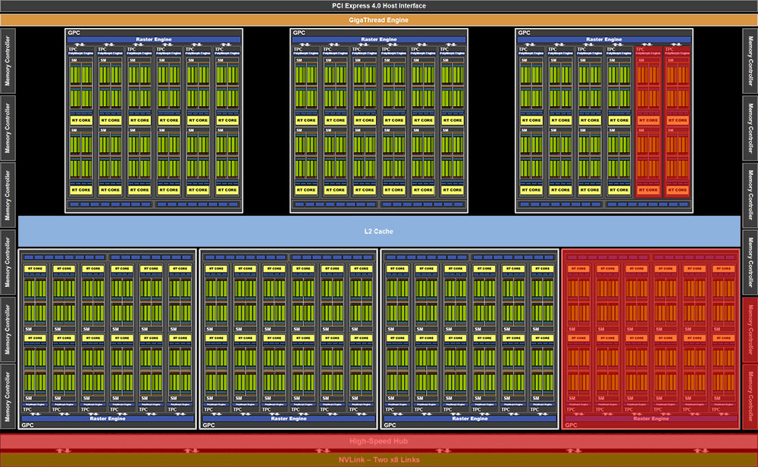
RTX 3080

Slide 8
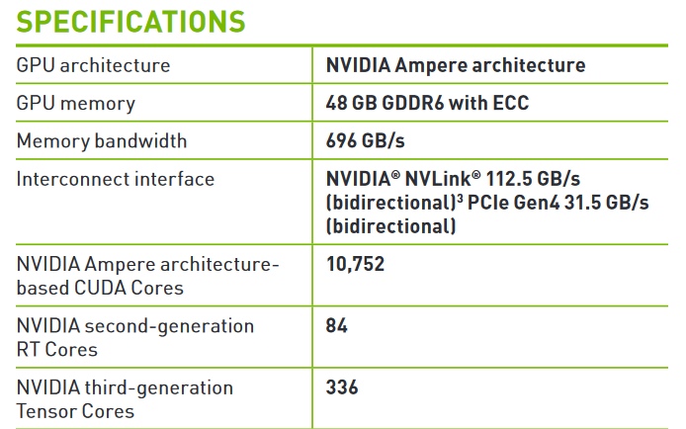
NVIDIA A40

Slide 9
CPU vs GPU?
Cores
Frequency
Core complexity

Slide 10
Arhitectura system heterogen
CPU
“HOST”
GPU
“DEVICE”
RAM
VRAM

Slide 11
Typical Program
CPU alocă memorie pe GPU (în VRAM)
CPU copiază date din RAM în VRAM
CPU pornește kernelul pe GPU
CPU copiază date din VRAM pe RAM

Slide 12

Open Standard for Parallel Programming of Heterogeneous Systems

Slide 13



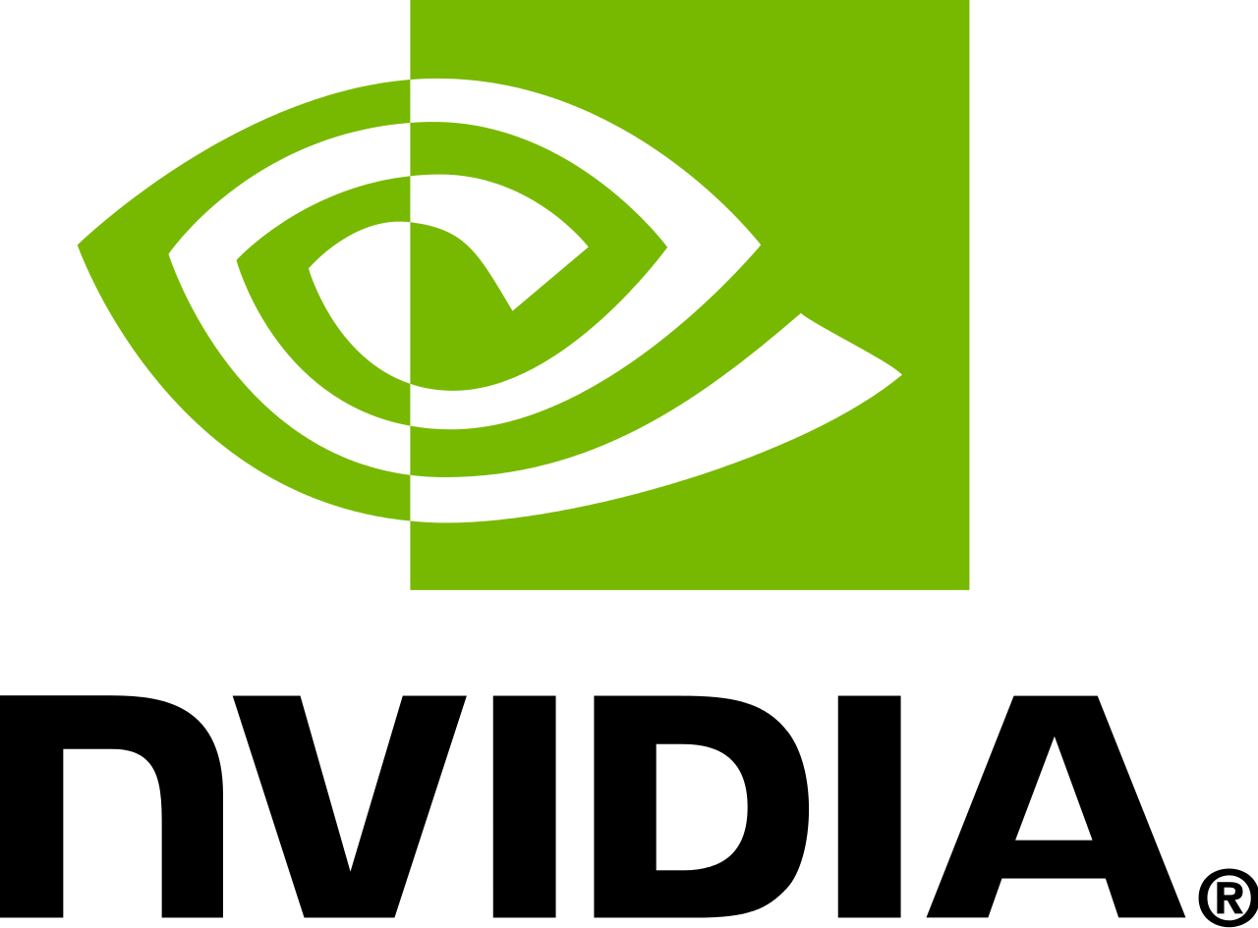



Slide 14
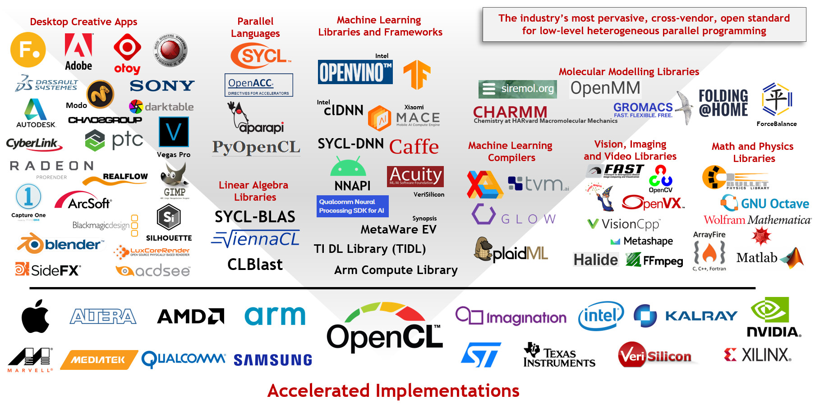

Slide 15
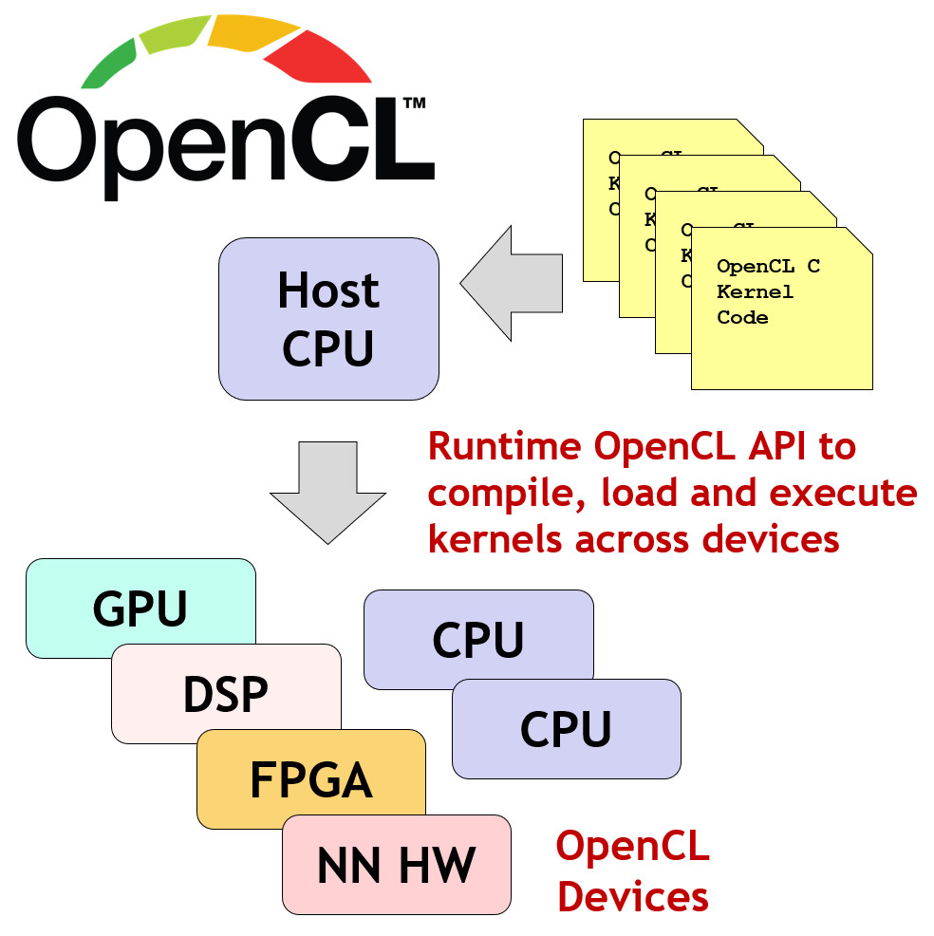

Slide 16
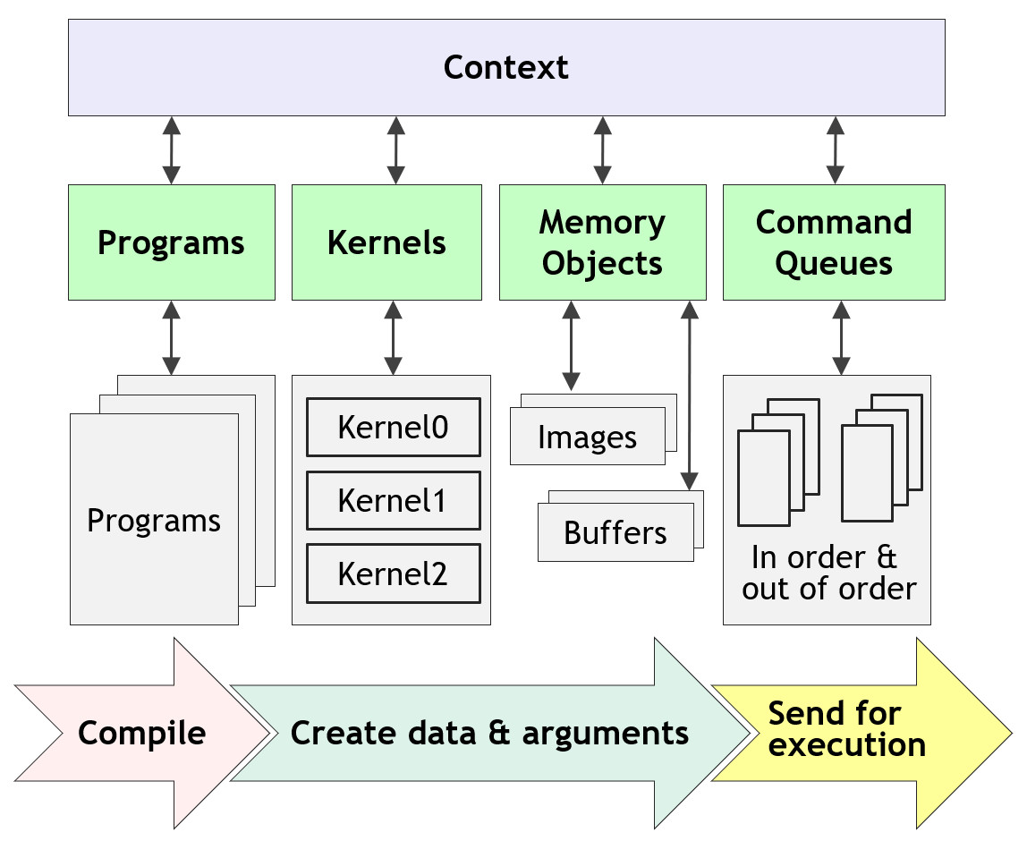
Sequence for Executing OpenCL Kernels

Slide 17
A complete sequence for executing an OpenCL program
Query for available OpenCL platforms and devices
Create a context for one or more OpenCL devices in a platform
Create and build programs for OpenCL devices in the context
Select kernels to execute from the programs
Create memory objects for kernels to operate on
Create command queues to execute commands on an OpenCL device
Enqueue data transfer commands into the memory objects, if needed
Enqueue kernels into the command queue for execution
Enqueue commands to transfer data back to the host, if needed

Slide 18
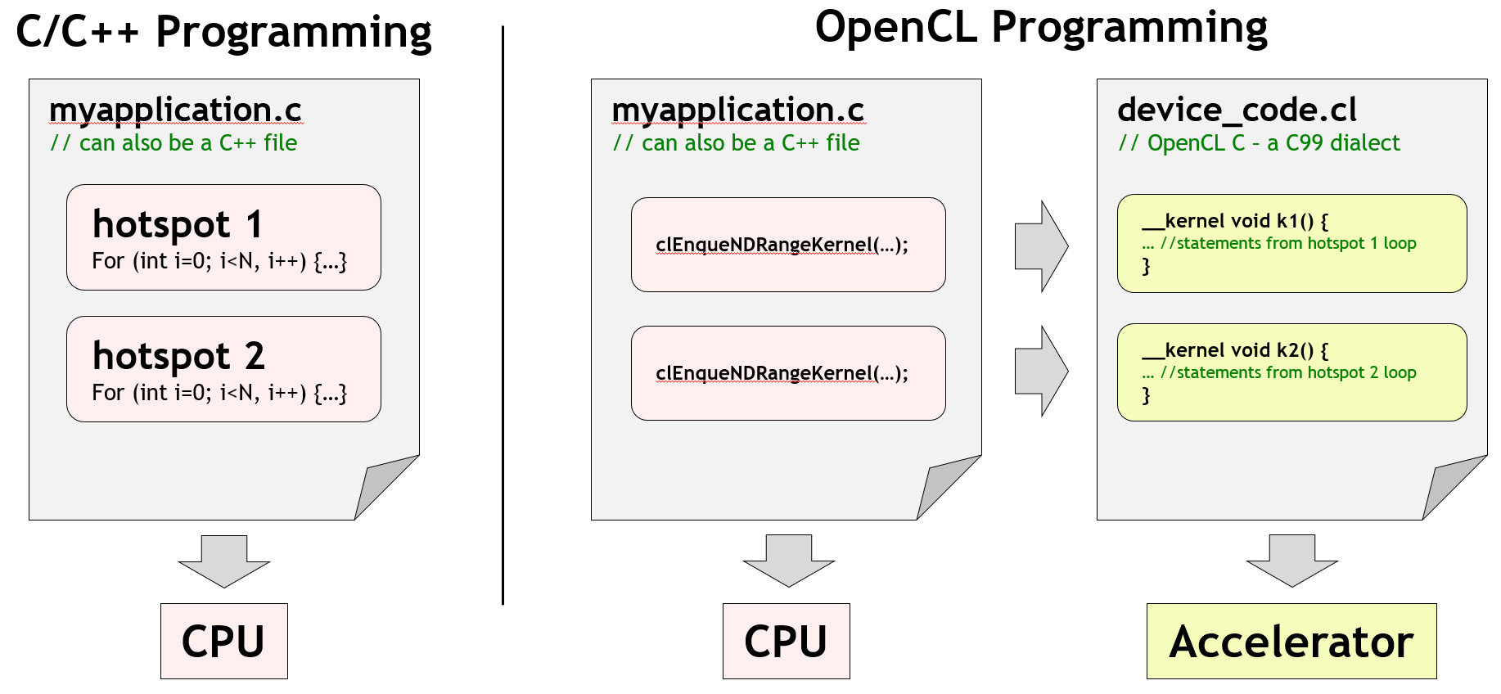
Traditional Versus OpenCL Programming Using OpenCL C Kernels

Slide 19
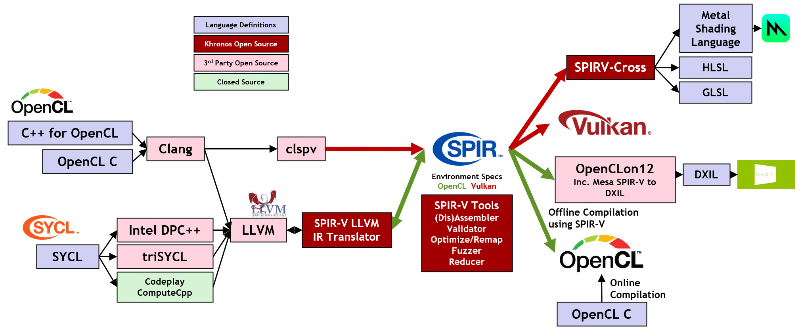
OpenCL Language Ecosystem Enabled With SPIR-V

Slide 20
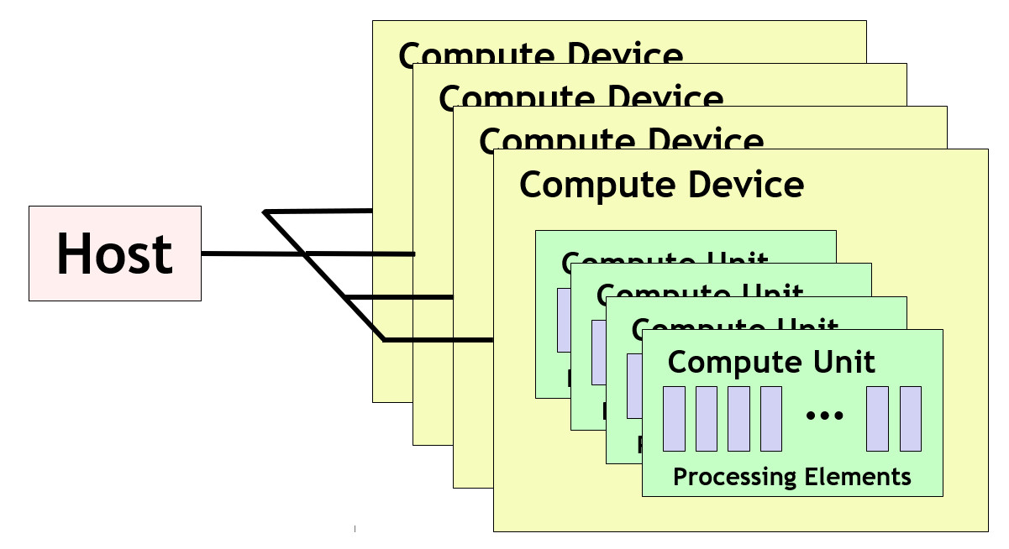
OpenCL Platform Model

Slide 21
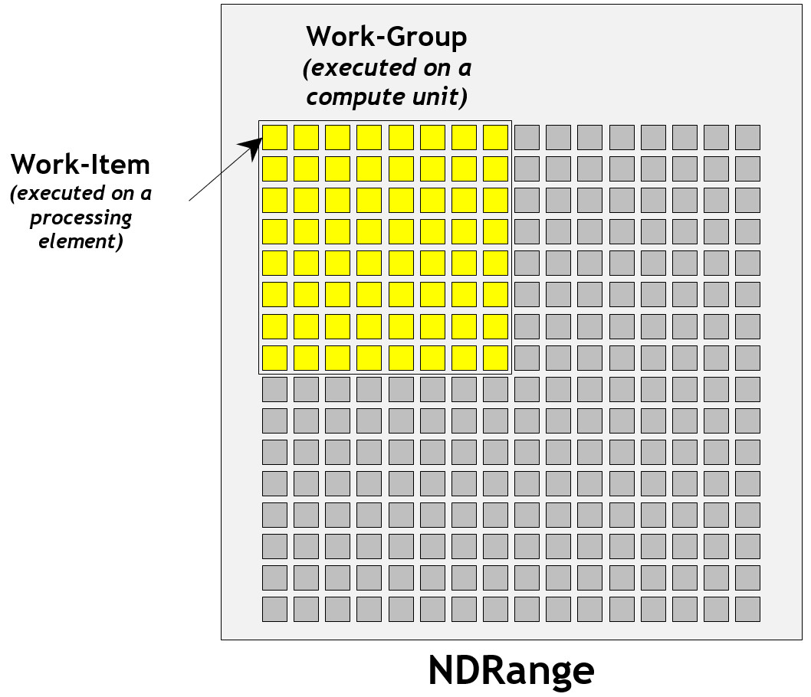
A 2D Image as an Example NDRange

Slide 22
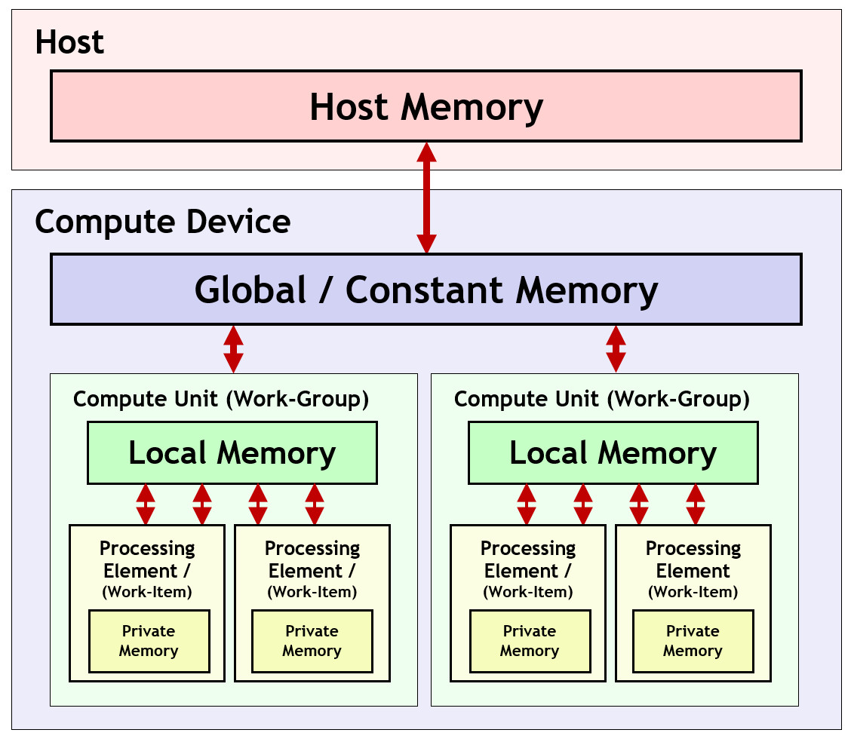
OpenCL Memory Model

